Slide 1

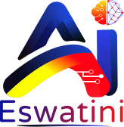
AI ESWATINI
BUILDING THE AI ENSEMBLE
“AI is the new electricity.”
People • Language • Robotics • Quantum • Applied AI
— Andrew Ng
COMMUNITY FIRST
Five communities.
One ecosystem. Built together.
Presented by Samkelo Msibi
AI Eswatini Community Launch
(Ng, 2017)
Notes:
Welcome and thank you. I'm Samkelo Msibi, and tonight is the launch of AI Eswatini.
Andrew Ng called AI 'the new electricity'. Electricity only changed the world when ordinary people could plug into it — that is exactly the point of tonight.
We are not launching a course. We are launching five communities that together form one ecosystem: People, Language, Robotics, Quantum and Applied AI.
By the end of this talk I want one thing from you: choose the community you will contribute to.

Slide 2

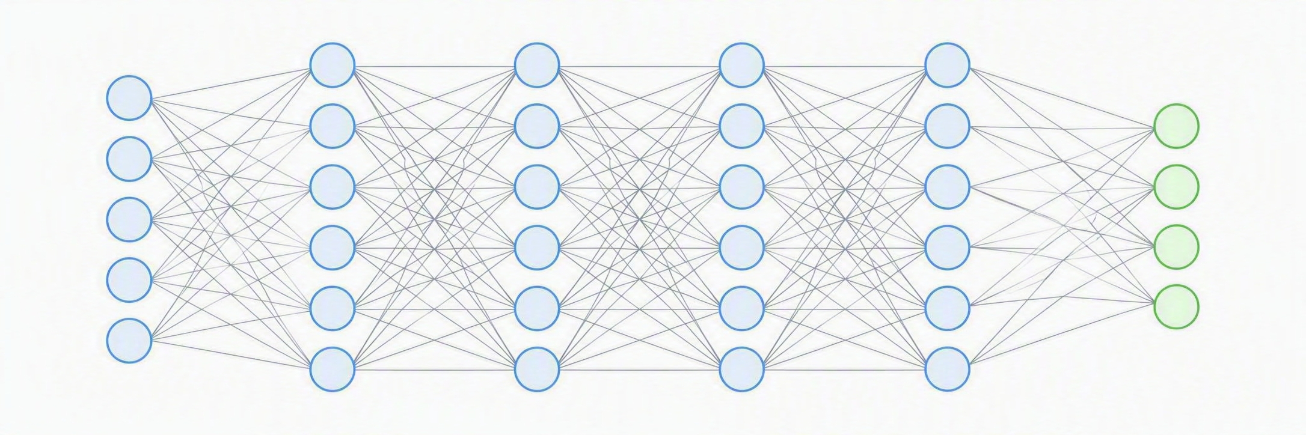
01 • WHY NOW
AI is no longer a future conversation
It is becoming a new layer of capability across science, industry and everyday life.
1
SEE
2
SPEAK
3
REASON
4
ACT
Computer vision
Language models
AI agents
Robotics
The strategic question is changing:
Who will have the people, data, institutions and communities to shape what AI becomes?
Framing informed by Ng (2017).
02
Notes:
AI is no longer a future conversation. It is already a layer of capability across science, industry and daily life.
Four capabilities matured together: machines can now see, speak, reason and act. Computer vision, language models, AI agents and robotics.
So the strategic question has changed. It is no longer 'will AI arrive?' — it is: who will have the people, data, institutions and communities to shape what AI becomes?
That question is the reason this ecosystem exists.

Slide 3
02 • GLOBAL IMPACT
When AI becomes infrastructure for discovery
AlphaFold is a powerful example of AI moving beyond automation into scientific discovery.
200M+
THE STORY
protein structure predictions available through the AlphaFold database
A problem that once required extensive experimental work can now be approached with AI predictions at extraordinary scale — giving researchers a new starting point for biology and medicine.
Deep neural network
IMPACT LESSON → AI matters most when people turn capability into discovery, services and solutions.
(Google DeepMind, 2022)
03
Notes:
Here is what that shift looks like at its best. AlphaFold moved AI beyond automation into scientific discovery.
Over 200 million protein structure predictions are now openly available — work that previously demanded years of laboratory effort.
The lesson is not the model. The lesson is that AI matters most when people turn capability into discovery, services and solutions.
Keep that word — people — it runs through the rest of this deck.

Slide 4
03 • AFRICA
Africa is already building — not only consuming
The strongest stories begin with a real problem, then combine technology with local systems.
RWANDA • DRONES + HEALTH
CONTINENT • AI + PRODUCTIVITY
Rwanda introduced drone delivery of blood products to remote health facilities. A Lancet Global Health study examined 20 facilities and found drone delivery improved delivery time and reduced wastage.
The African Development Bank estimates that inclusive AI deployment could generate up to US$1 trillion in additional African GDP by 2035 — if capability, infrastructure and inclusion grow with it.
Africa’s opportunity is not one technology. It is the ability to connect skills + infrastructure + local problems + communities.
(Nisingizwe et al., 2022; African Development Bank, 2025)
04
Notes:
Africa is already building, not only consuming.
In Rwanda, drone delivery of blood products to remote health facilities improved delivery times and reduced wastage — published in The Lancet Global Health.
At continental scale, the African Development Bank estimates inclusive AI deployment could add up to a trillion US dollars to African GDP by 2035 — if capability, infrastructure and inclusion grow with it.
Notice the pattern: a real problem, technology, and local systems combined.

Slide 5
04 • SADC
Southern Africa is building institutional AI capability
The region offers examples of what happens when research, skills and sector challenges are connected.
SOUTH AFRICA
CAPABILITY MODEL
THE LESSON
Artificial Intelligence Institute of South Africa
RESEARCH
universities
Regional capability grows when communities and institutions organise around practical areas of focus.
AI hubs have been linked to sectors including automotive, health, mobility, manufacturing, mining and criminal justice.
SKILLS
people
SECTORS
real problems
(Department of Communications and Digital Technologies, South Africa, 2023; 2024)
05
Notes:
Closer to home, Southern Africa is building institutional capability.
South Africa's Artificial Intelligence Institute has hubs linked to sectors: automotive, health, mobility, manufacturing, mining and criminal justice.
The model is simple: research plus skills plus sectors. Universities, people, and real problems.
The lesson for us: regional capability grows when communities and institutions organise around practical areas of focus.

Slide 6
05 • LANGUAGE
A community can change what technology understands
Masakhane showed how participatory research can expand African language technology.
30+
WHY THIS STORY MATTERS FOR ESWATINI
African languages represented in machine-translation benchmarks
The Masakhane model did not wait for one institution to solve African NLP. Researchers and contributors organised as a community — creating datasets, benchmarks, models and scientific participation.
Community is not the audience around innovation. Community can be the engine that produces it.
(Nekoto et al., 2020)
06
Notes:
This slide is my favourite, because it shows community can be the engine.
Masakhane is a participatory research community — not one funded institution — and it helped expand machine translation to more than thirty African languages.
Researchers and contributors built datasets, benchmarks, models and published science together.
So: community is not the audience around innovation. Community can be the thing that produces it.

Slide 7






06 • ESWATINI
So where do we choose to stand?
Eswatini does not need to solve every AI problem. These six assets are where our context gives us something no one else can build for us.
PEOPLE
LANGUAGE
INDUSTRY
Young, connected talent that needs real routes to participate — not another audience to sit in a workshop.
siSwati is barely present in today’s AI systems. That gap is ours to close, and nobody else will close it for us.
Agriculture, health, finance and public services carry problems where AI can add measurable value.
RESEARCH
PROBLEMS
OPPORTUNITY
Universities and researchers who can turn local questions into datasets, publications and expertise.
Challenges a team in Silicon Valley will never fully understand — because we live inside them.
The datasets, tools and models do not exist yet. Whoever builds them first defines how they work.
The question is not how we copy Silicon Valley — it is what an AI ecosystem designed for Eswatini should look like.
07
Notes:
So where do we choose to stand? Eswatini does not need to solve every AI problem.
We have six assets: young connected talent; siSwati, a language barely present in today's systems; industries with real problems; researchers who can turn local questions into datasets and publications; problems nobody outside can fully understand; and an open opportunity, because the datasets and tools do not exist yet.
The question is not how we copy Silicon Valley. It is what an AI ecosystem designed for Eswatini should look like.

Slide 8

07 • THE REVEAL
Building the AI Ensemble
Five communities. Different missions. One ecosystem.
WOMEN
IN AI
NLP
ESWATINI
ROBOTICS
AI
QUANTUM
AI
APPLIED
AI
PEOPLE
LANGUAGE
PHYSICAL AI
FRONTIER
IMPACT
The programmes are communities: places to learn, contribute, collaborate, build and eventually lead.
08
Notes:
This is the reveal. Five communities, different missions, one ecosystem.
Women in AI — people. NLP Eswatini — language. Robotics AI — physical AI. Quantum AI — frontier. Applied AI — impact.
These are not classes with an end date. They are communities: places to learn, contribute, collaborate, build and eventually lead.
Let me take you through each one.

Slide 9
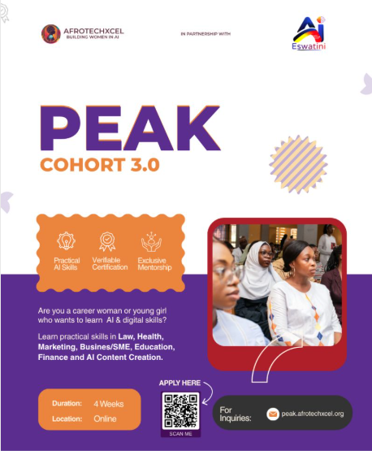
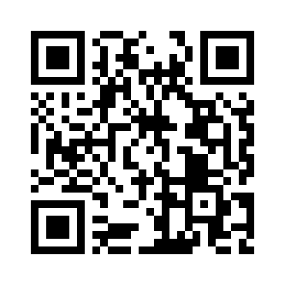
08 • PEOPLE
Women in AI Eswatini
A community designed to widen participation and create pathways from learning to leadership.
1
2
3
4
5
LEARN
CONNECT
BUILD
LEAD
MENTOR
COMMUNITY EXPERIENCES
Mentorship • Technical workshops • Research • Projects • Career development • Networking • Leadership opportunities
You do not need to arrive as an expert. You need the willingness to learn and contribute.
09
Notes:
Women in AI Eswatini is about widening participation and creating pathways from learning to leadership.
The journey is five steps: learn, connect, build, lead, mentor — and the last step matters most, because today's participant becomes tomorrow's mentor.
Community experiences include mentorship, technical workshops, research, projects, career development, networking and leadership opportunities.
The PEAK Cohort 3.0 is open now — practical AI skills across law, health, marketing, business, education, finance and content creation. Scan the QR code to apply.
And remember: you do not need to arrive as an expert. You need the willingness to learn and contribute.

Slide 10
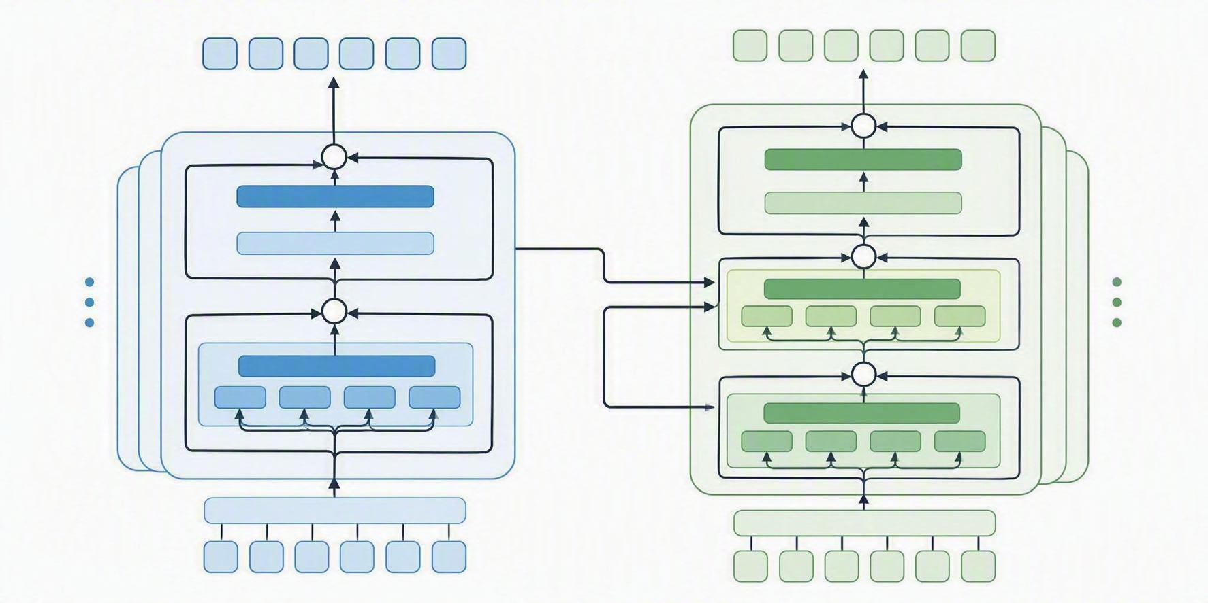
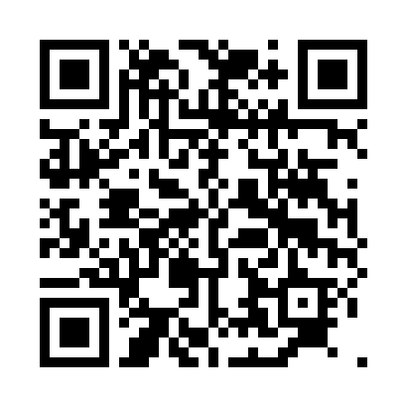
09 • LANGUAGE
NLP Eswatini
What if intelligent systems could understand, speak and create with siSwati in meaningful local contexts?
“Sawubona. Ngingakusita ngani?”
BUILD DATA
BUILD MODELS
siSwati corpora • annotation • evaluation
translation • speech • conversational AI
The future of language AI should include our language, culture and knowledge.
BUILD RESEARCH
BUILD COMMUNITY
African NLP • LLMs • publications
developers • linguists • students • researchers
SCAN ME TO JOIN
Scan with your phone camera
Transformer architecture: attention-based encoder-decoder
Community model inspired by participatory African NLP research (Nekoto et al., 2020).
10
Notes:
NLP Eswatini asks a simple question: what if intelligent systems could understand, speak and create with siSwati?
We work in four directions: build data — siSwati corpora, annotation and evaluation; build models — translation, speech and conversational AI; build research — African NLP, LLMs and publications; and build community — developers, linguists, students and researchers.
If we do not create siSwati data, nobody will do it for us. Scan the QR to join.

Slide 11





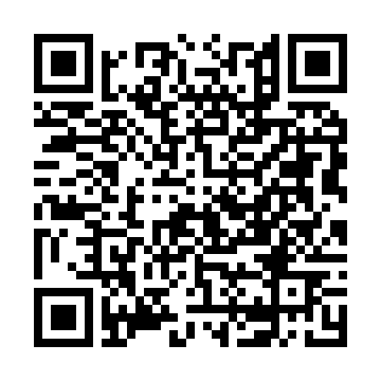
10 • PHYSICAL AI
Robotics AI
When intelligence leaves the screen, it begins to sense, decide and act in the physical world.
SENSE
UNDERSTAND
DECIDE
ACT
cameras • sensors
vision • AI
planning • control
robots • drones
Potential community domains
Agriculture • Manufacturing • Inspection • Education • Embedded systems • Autonomous systems • IoT
SCAN ME TO JOIN
Scan with your phone camera
11
Notes:
Robotics AI is where intelligence leaves the screen.
The loop is sense, understand, decide, act — cameras and sensors, vision and AI, planning and control, robots and drones.
The domains are close to home: agriculture, manufacturing, inspection, education, embedded systems, autonomous systems and IoT.
This community is hands-on. If you like building things that move, scan and join.

Slide 12

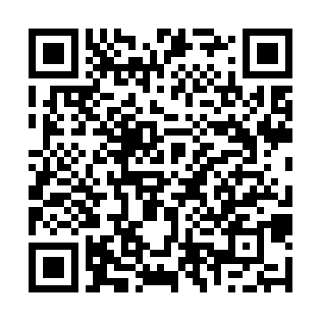
11 • FRONTIER
Quantum AI
A learning and research community for understanding an emerging computing paradigm — without the hype.
WHAT WE WILL DO
WHY START NOW?
• Quantum computing fundamentals
• Quantum algorithms
• Quantum machine learning
• Optimisation
• Hybrid quantum–classical systems
• Research reading groups
Emerging technologies should not reach our students and researchers only after the rest of the world has already built the expertise.
We start by learning. We grow by experimenting.
SCAN ME TO JOIN
Scan with your phone camera
12
Notes:
Quantum AI is a learning and research community for an emerging paradigm — without the hype.
We will cover quantum computing fundamentals, algorithms, quantum machine learning, optimisation, hybrid quantum-classical systems, and run research reading groups.
Why now? Because emerging technologies should not reach our students and researchers only after the rest of the world has already built the expertise.
We start by learning. We grow by experimenting.

Slide 13






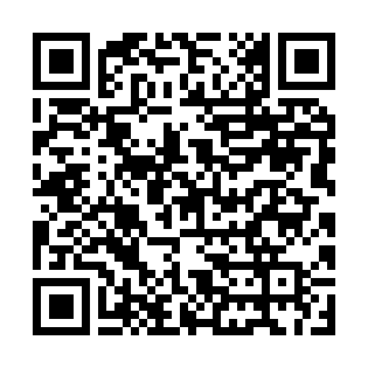
12 • IMPACT
Applied AI
Applied AI pairs technology people with domain experts and starts every project with one question, not with a tool.
“What problem do we have — and can AI meaningfully help us solve it?”
AGRICULTURE
HEALTH
EDUCATION
Crop health, disease detection and weather-informed advice for smallholder farmers.
Diagnostic support, triage and better service delivery in rural clinics.
Learning support and teaching materials in both siSwati and English.
INDUSTRY
FINANCE
PUBLIC SERVICES
Quality inspection, predictive maintenance and process optimisation.
Fraud detection, credit scoring and wider financial inclusion.
Faster citizen services and smarter use of national data.
Identify
Form teams
Prototype
Test
Research
Deploy
SCAN ME TO JOIN
Scan with your phone camera
→
→
→
→
→
13
Notes:
Applied AI is where the other communities meet reality.
It pairs technology people with domain experts and starts every project with one question, not with a tool: what problem do we have — and can AI meaningfully help us solve it?
The fields are agriculture, health, education, industry, finance and public services.
The method is a pipeline: identify, form teams, prototype, test, research, deploy. Scan to join a project team.

Slide 14
13 • TOGETHER
One challenge. Many communities.
A single Eswatini use case can become a collaboration across the ensemble.
EXAMPLE: SMART AGRICULTURE
NLP ESWATINI
siSwati farmer interface
ROBOTICS AI
drones, sensors, computer vision
APPLIED AI
field problem + deployment
QUANTUM AI
future optimisation research
WOMEN IN AI
participation + leadership pathways
THAT IS THE ENSEMBLE.
14
Notes:
Here is how the ensemble works in practice. Take one Eswatini challenge: smart agriculture.
NLP Eswatini builds the siSwati farmer interface. Robotics AI provides drones, sensors and computer vision. Applied AI owns the field problem and deployment. Quantum AI explores future optimisation research. Women in AI drives participation and leadership pathways.
One challenge, five communities, one solution. That is the ensemble.

Slide 15
14 • YOUR MOVE
This is a community -not just a course
We are not recruiting an audience. We are inviting contributors.
CURIOUS
LEARN
PARTICIPATE
BUILD
RESEARCH
LEAD
MENTOR
Students • Developers • Researchers • Engineers • Linguists • Designers • Entrepreneurs • Domain experts • Beginners
EXPERIENCE IS WELCOME. CURIOSITY IS REQUIRED.
Choose your community. Apply. Learn. Contribute. Help build what comes next.
15
Notes:
So this is your move. This is a community, not just a course — we are not recruiting an audience, we are inviting contributors.
Your path can start anywhere: curious, learn, participate, build, research, lead, mentor.
Students, developers, researchers, engineers, linguists, designers, entrepreneurs, domain experts and complete beginners all belong here.
Experience is welcome. Curiosity is required. Choose your community, apply, learn, contribute — and help build what comes next.

Slide 16
15 • SOURCES
References
Selected sources supporting the impact stories and regional examples used in this presentation.
1. Stanford Graduate School of Business. (2017). Andrew Ng: Why AI Is the New Electricity.
2. Google DeepMind. (2022). AlphaFold reveals the structure of the protein universe.
3. Nisingizwe, M. P., et al. (2022). Effect of unmanned aerial vehicle (drone) delivery on blood product delivery time and wastage in Rwanda. The Lancet Global Health, 10(4), e564–e569. https://doi.org/10.1016/S2214-109X(22)00048-1
4. African Development Bank. (2025). Africa’s AI Productivity Gain: Pathways to Labour Efficiency, Economic Growth and Inclusive Transformation.
5. Department of Communications and Digital Technologies, South Africa. (2023). Shaping South Africa’s Digital Future: Launch of the TUT Hub of the Artificial Intelligence Institute of South Africa.
6. Department of Communications and Digital Technologies, South Africa. (2024). Launch of the 4th Hub of AIISA — Defence Artificial Intelligence Research Unit.
7. Nekoto, W., et al. (2020). Participatory Research for Low-resourced Machine Translation: A Case Study in African Languages. Findings of EMNLP 2020, 2144–2160. https://doi.org/10.18653/v1/2020.findings-emnlp.195
16
Notes:
These are the sources behind tonight's claims — Stanford, Google DeepMind, The Lancet Global Health, the African Development Bank, South Africa's Department of Communications and Digital Technologies, and the Masakhane research.
I'm happy to share the deck and these references with anyone who wants them.
Thank you — now let's talk, and let's get you into a community.

